Slide 1
DESIGN-TEK, INC.
MOTION CONTROL PRODUCTS
ENGINEERING/DESIGN SERVICES
DESIGN PRODUCTS FOR CUSTOMERS

Slide 2
SERVICES
GENERAL ENGINEERING, DESIGN, AND DRAFTING
PRODUCT DEVELOPMENT
MACHINE DESIGN
TEST EQUIPMENT
PROTOTYPE FABRICATION
RAPID PROTOTYPING

Slide 3
PRODUCTS (STANDARD & CUSTOM)
GEARHEADS
X-Y TABLES
ROTARY TABLES
ACTUATORS
CUSTOM ACCESSORIES

Slide 4
GEARHEADS (STANDARD & CUSTOM)
PLANETARY
SPUR
WORM BOXES

Slide 5
X-Y TABLE – MECHANICAL DRIVES
LEAD SCREW
BELT DRIVE
CABLE DRIVE
RACK & PINION

Slide 6
ROTARY TABLES
SPUR GEAR DRIVE
WORM GEAR DRIVE
OPTIONS:
THRU CENTER HOLE IN TABLE

Slide 7
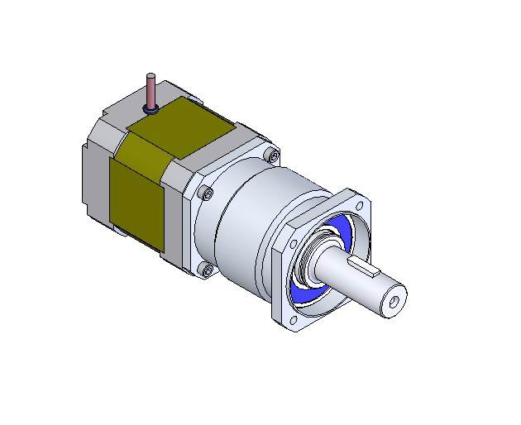
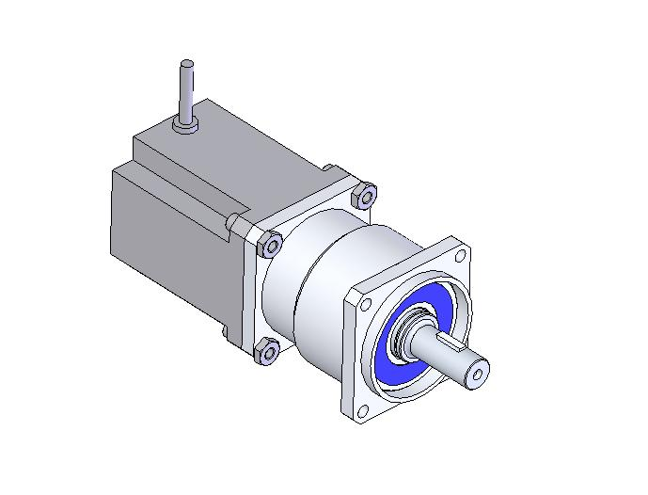
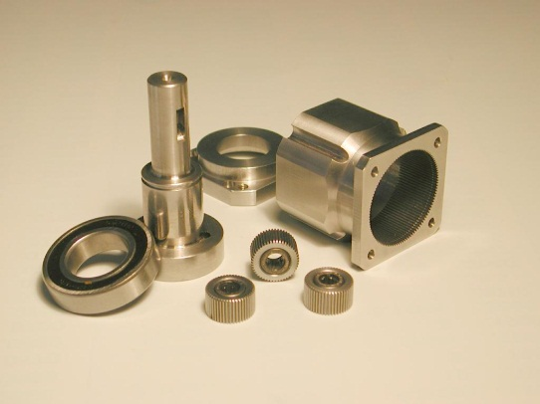
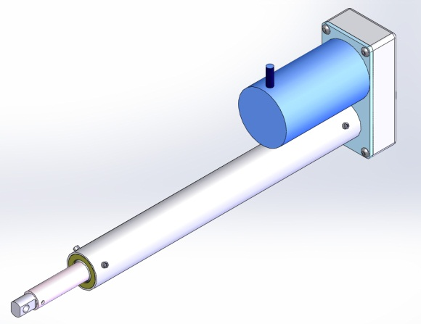
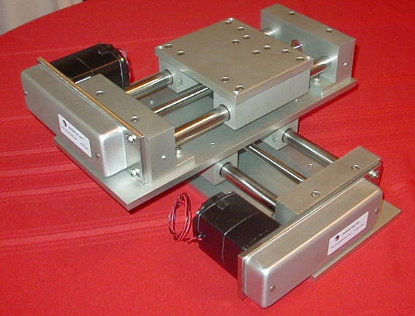
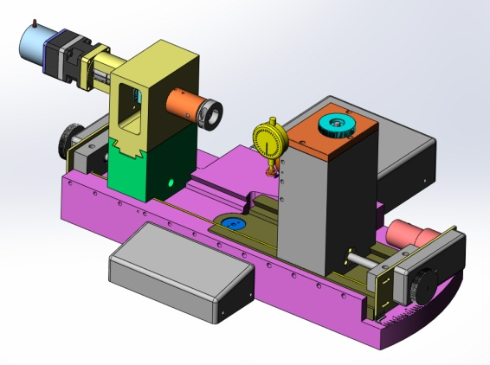
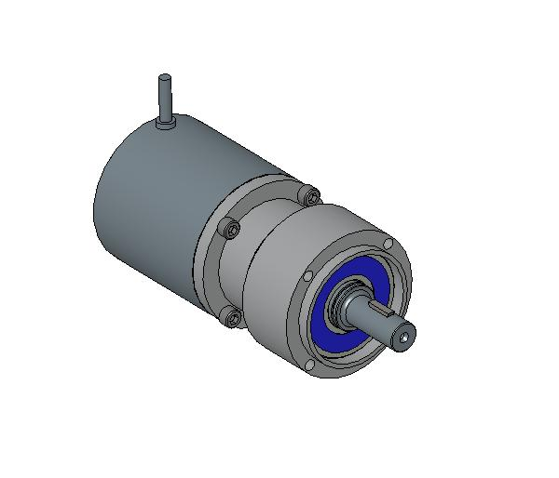
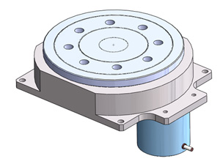
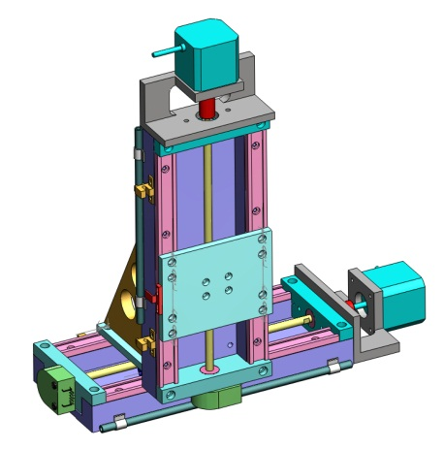

Slide 8
CUSTOM ACCESSORIES
SPLINES
SPUR/ HELICAL GEARS
WORM GEAR SETS
HELICAL GEARS
BEVEL GEARS
SPROCKETS
TIMING BELT PULLEYS
COMPOUND TIMING BELT PULLEYS
V BELT PULLEYS
BULL GEAR ARRANGEMENTS

Slide 10
INDUSTRIES SERVED
AEROSPACE
MEDICAL
FACTORY AUTOMATION
SPACE
NATIONAL LABS
NASA

Slide 11
CONTACT US
DESIGN-TEK, INC.
E-MAIL: RON.DTI@COMCAST.NET
PH: 503-487-6907
FAX: 503-487-6589
WWW.DESIGN-TEK.COM

